Slide 1
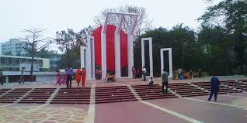
WELCOME

Slide 2
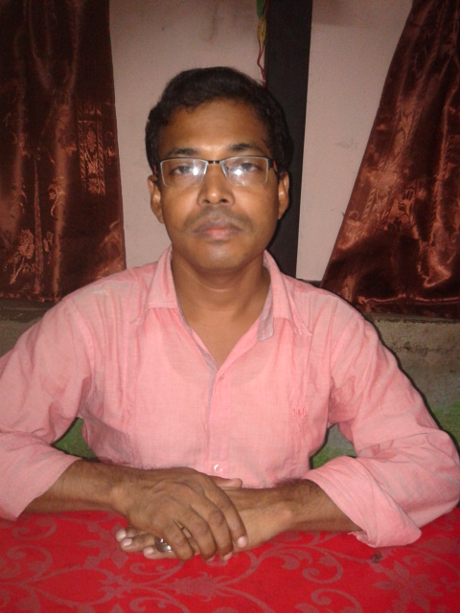
Identity:
1.Murad Hossain
Assistant Teacher
Montejar RAHMAN Mia GIRLS school
Shailkupa,Jhenidah.
Mob:01743927217
E-mail;muradhossain152@gmail.com
Class:Nine
Sub:English for today
Unit-3,Lesson-3
Time:50 minutes
Date:08-11-2015

Slide 3
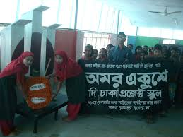
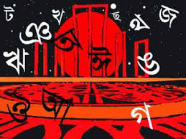
1.What is the picture about?
2.What do you think about it?
3.What is the new name of 21 February?

Slide 4
Lesson:
International Mother Language Day-1

Slide 5
Learning outcomes:
At the end of the lesson the students will be able to
1.Read the text appropriately.
2.Describe the historical events of 1947,1948,1952.
3.Match the words with their meaning using section D.
4.Answer the questions oraly in section E.

Slide 6
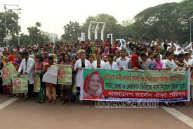
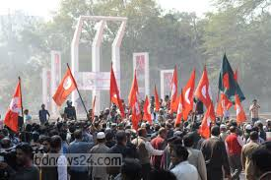
See words.Tribute,climax,defy.
Say the meaning of the words.
Tribute
Climax,defy.

Slide 7
Students read the text
21 February is a memorable day …………………………
……..Bangladesh.

Slide 8
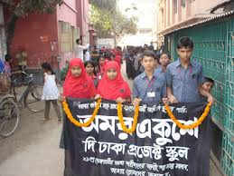

Slide 9
Group work
1.Why do you observe 21 February as the International
Mother Language Day?
2.Write the historical events of 1947,1948,1952.
3.Match the words with their meanings in section D.
:

Slide 10
Evaluation
When did undevided Indid devided?
2.When Md.Ali Zinnah declared Urdu Urdu shall be the state language of Pakistan?
3Where did he declare it?
4.When did the students bringout a peaceful protest procession?
Who were died in protect procession?
6.Where the police fire on?

Slide 11
Home work
Write briefly how you observed this year’s21 February at your school.

